Slide 1
Intro to R
January 17, 2017
John Little and Joel Herndon
askdata@duke.edu
Notes:
Conventions- courier font means code

Slide 2
Goals for Today’s Workshop
1. Learn how to work with R using Rstudio
2. Be able to load data into R for analysis
3. Learn how to manage/clean/analyze data in R
ALSO: Answer your questions about R! (just ask anytime)
ALSO: Some previews of cool things you can do with R.

Slide 3
Why R?
R is a powerful tool for stats, but it can also...

Slide 4
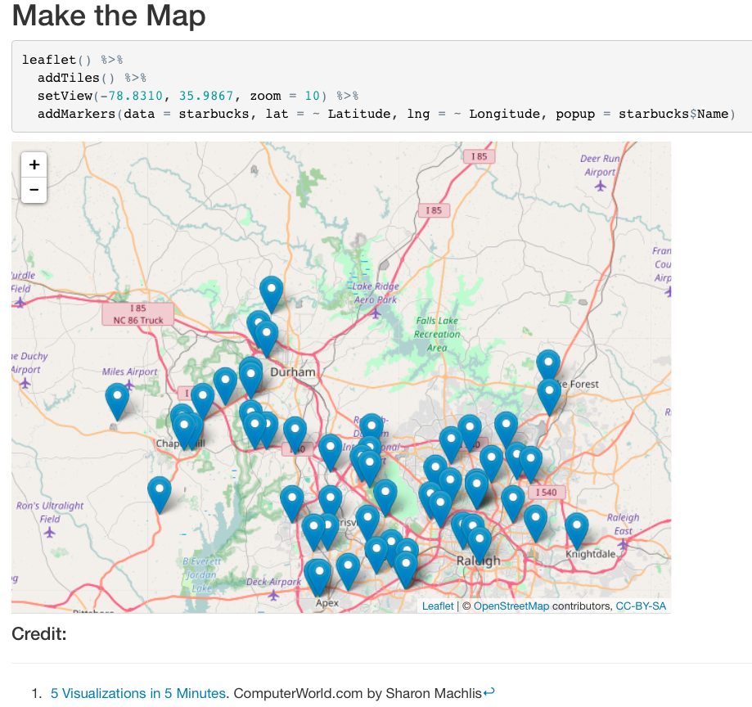
Create data driven maps...

Slide 5
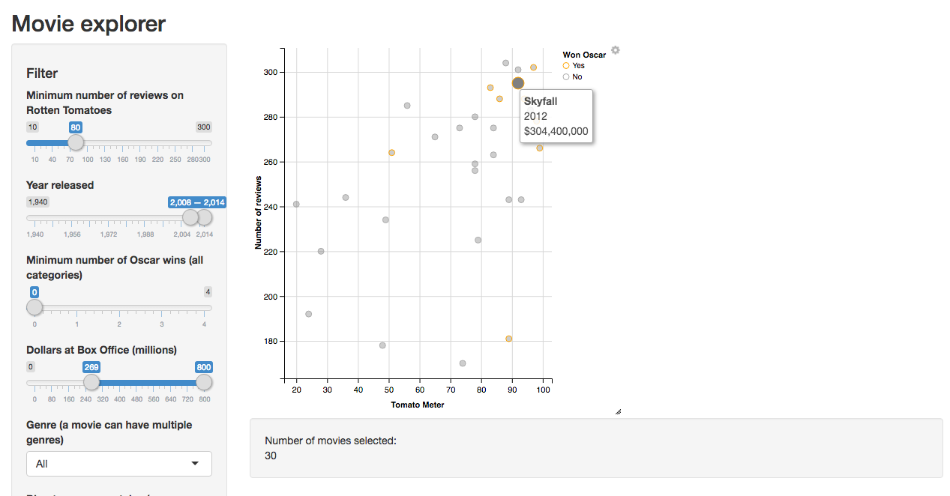
Create a interactive website...
http://shiny.rstudio.com/gallery/movie-explorer.html

Slide 6
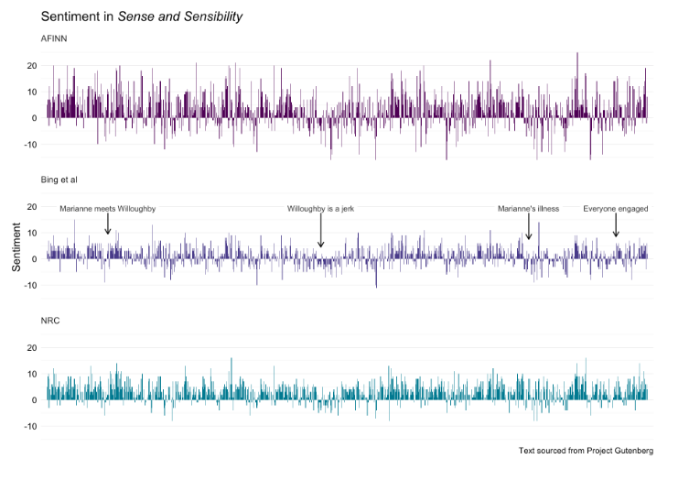
Text/sentiment analysis...
http://juliasilge.com/blog/If-I-Loved-NLP-Less/

Slide 7
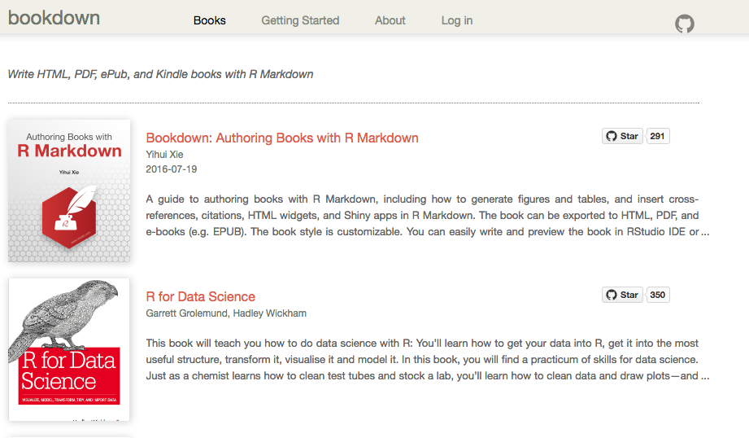
You could write a book in R...
bookdown.org

Slide 8








Extending R
...And many more....

Slide 9

Packages extend R to novel situations
https://www.youtube.com/watch?v=6AOpomu9V6Q

Slide 10
Background
Notes:
1. How many people have used a statistics package before? Which packages?
2. How many people have coded using a programming language before? Which languages?
3. How many of you have to use R for class? your own research? just interested?

Slide 11


R and R Studio
I’m the open source statistical programming language.
I’m a development environment for using the R programming language.
Notes:
After this slide, we do a bit of housekeeping.
get everyone in the same directory
access to files

Slide 12
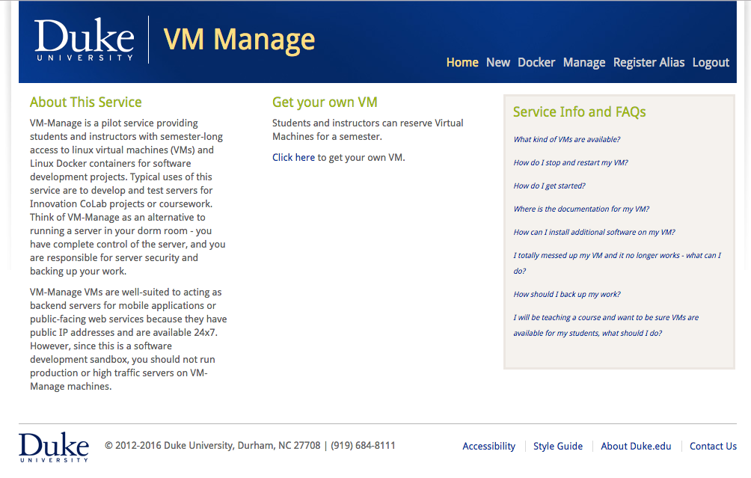
vm-manage.oit.duke.edu

Slide 13
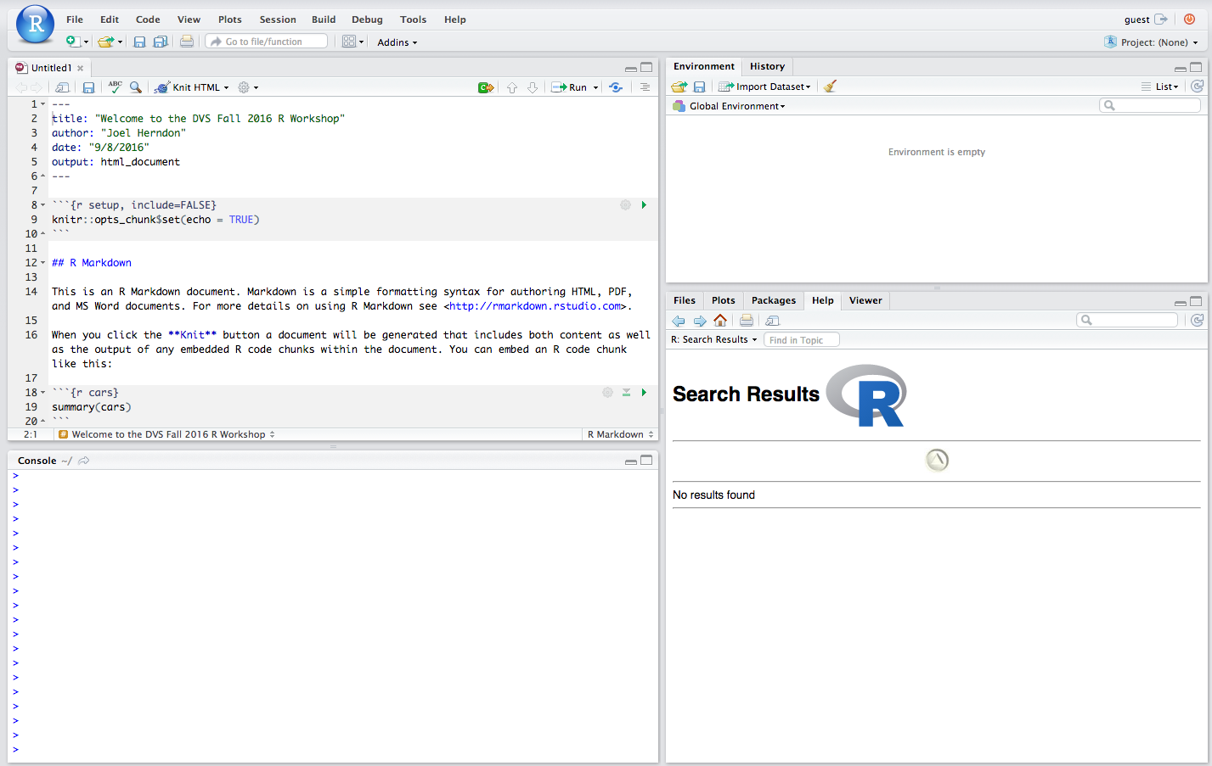

Slide 14
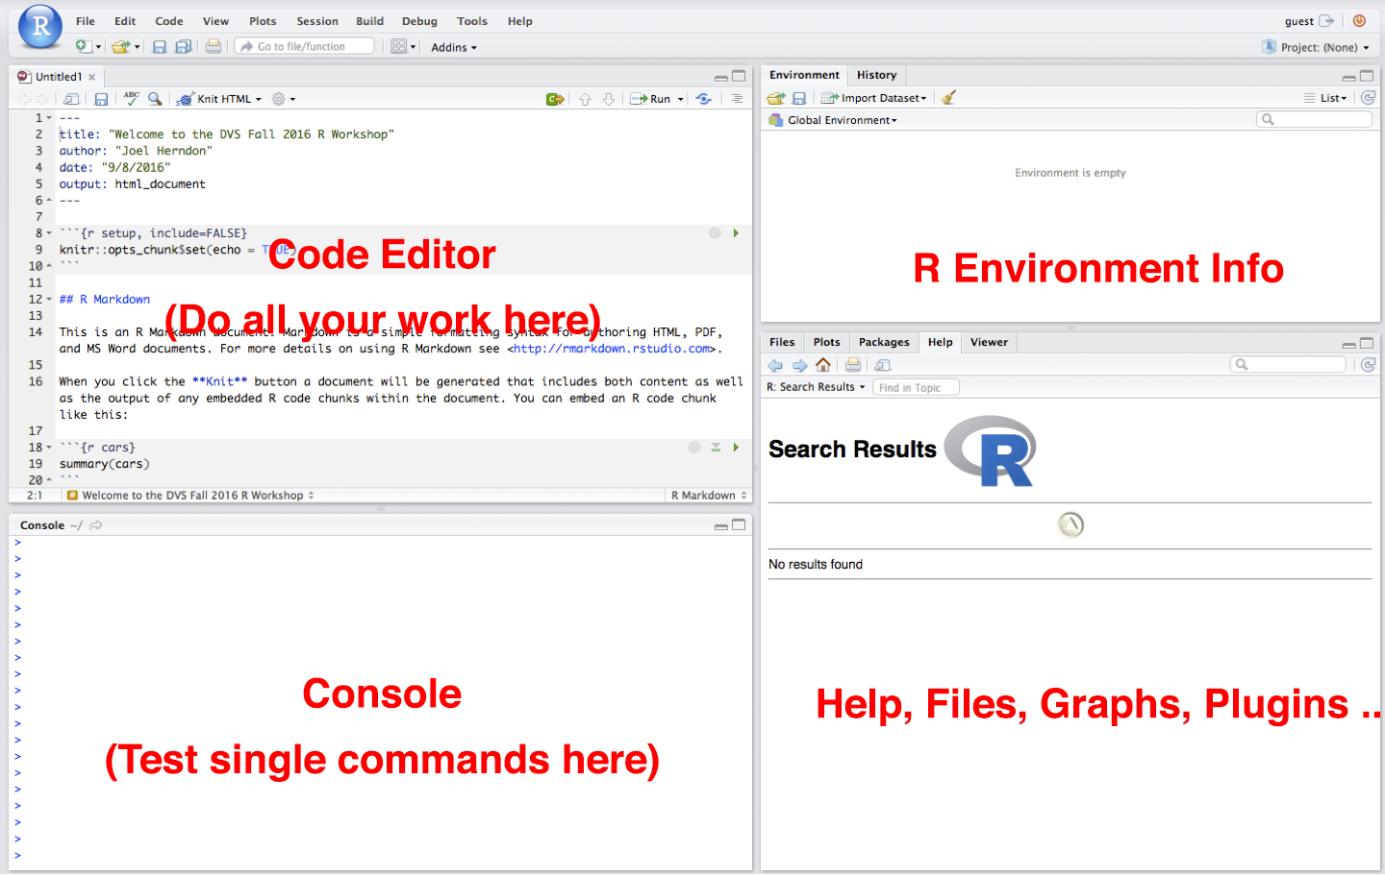

Slide 15
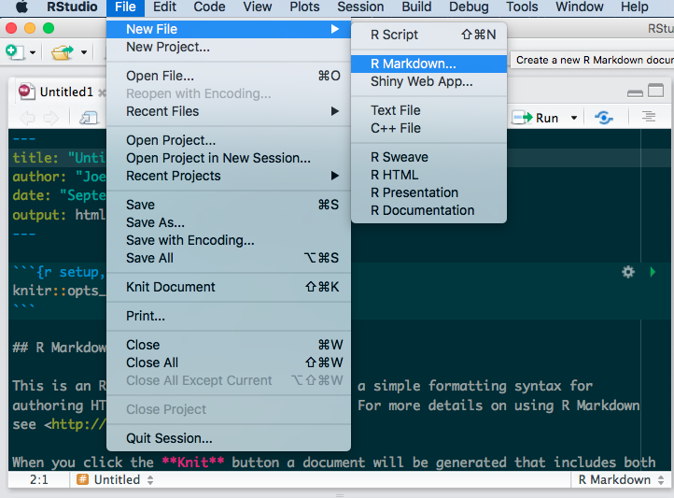
Writing Code in R
R provides several options for writing code

Slide 16
R Markdown
We are using R Markdown today (files that end in .Rmd)
R Markdown allows us to write regular text and add R code chunks that run code in R
R Markdown helps us to share code with context (or to write code in a way that you can remember what it does later.
R Markdown also allows us to output our text and R results as HTML, PDF, or Word documents.

Slide 17
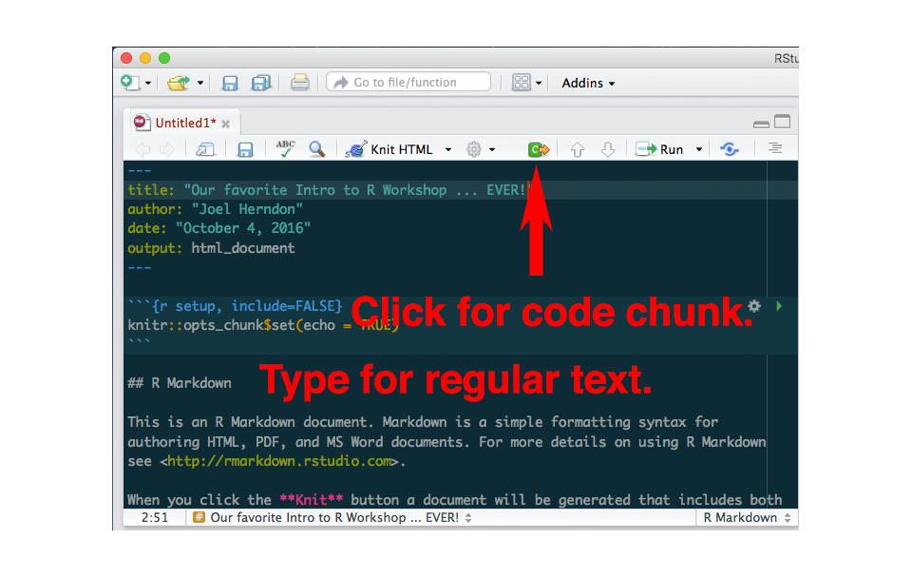
R Markdown

Slide 18
R Markdown
R code generally lives inside blocks that look like this:
```{r}
R code goes here
```
Regular text appears through the rest of the document
You can read more about formatting your text in the markdown reference in the ”Help” menu.

Slide 19
Files and projects
Intro2R

Slide 20
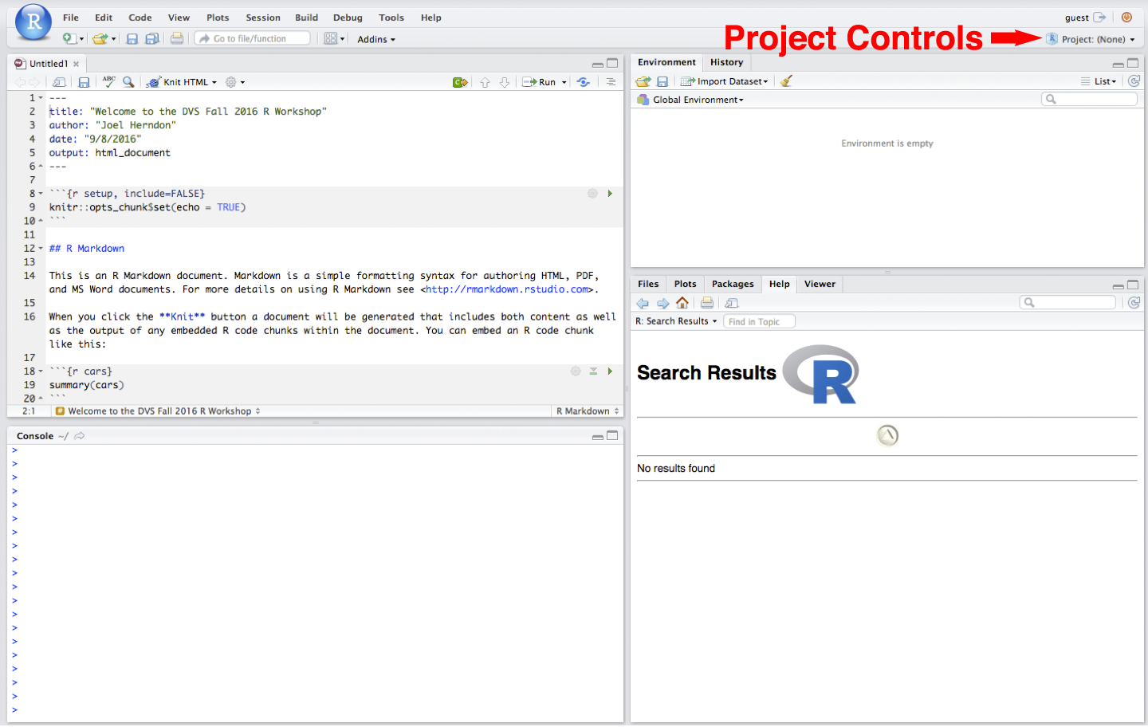

Slide 21
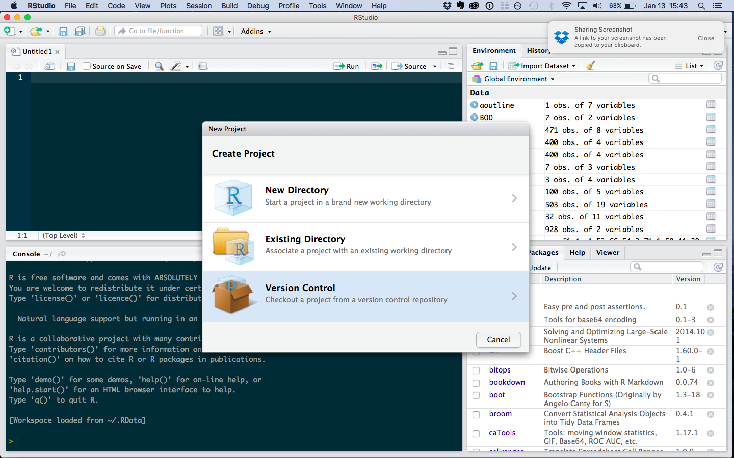

Slide 22
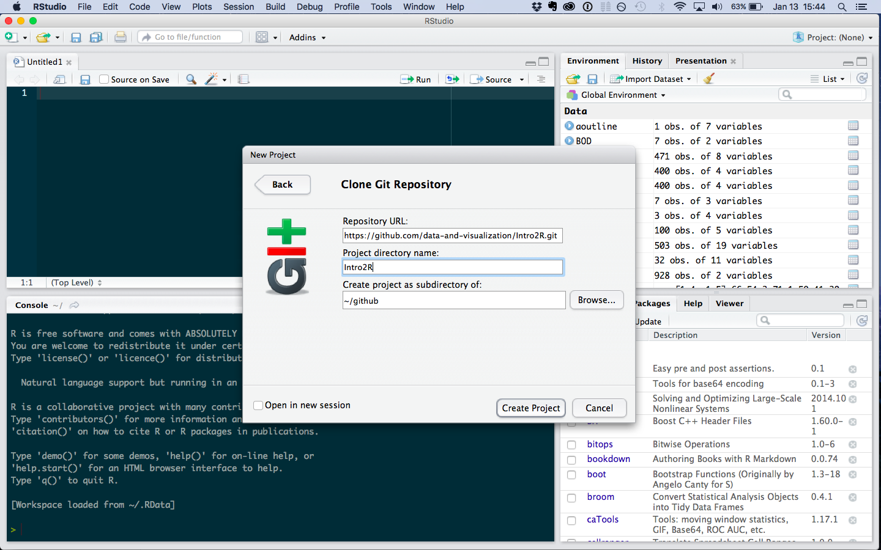

Slide 23
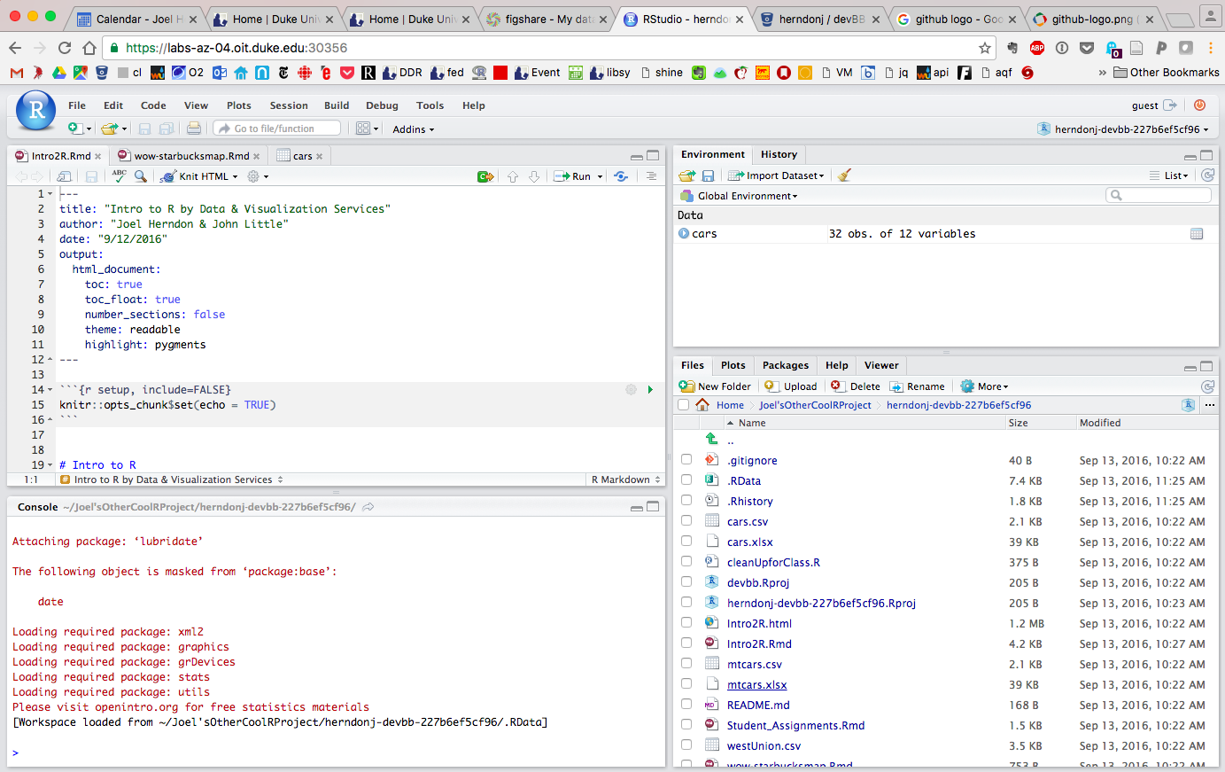

Slide 24
HELP!

Slide 25


http://r4ds.had.co.nz/
http://www.statmethods.net/

Slide 26




Getting Help Online
Google – add“r” or “rstats” to your search
Stack Overflow – add “[r]” to your search
rseek.org (Google, but focused on R)
Quick R – statmethods.net

Slide 27
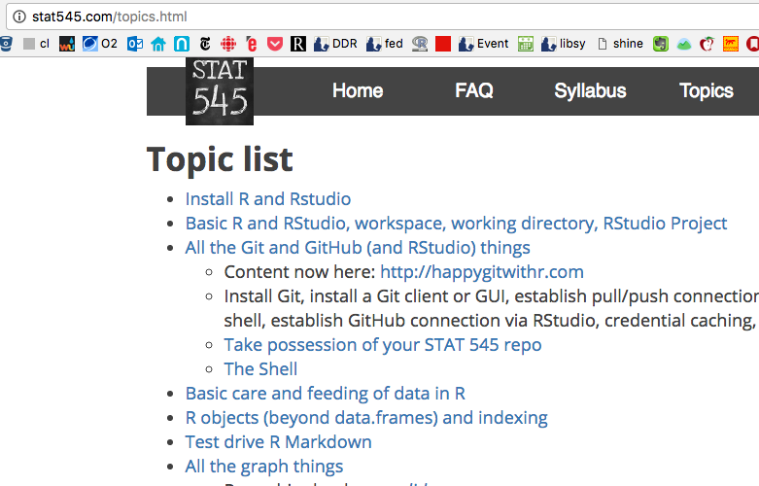
Stat545 – Jenny Bryan’s UBC Course on Stats in R
Notes:
And a personal favorite....

Slide 28
Getting Help At the Command Line
help(functionName) or ?functionName
??topic #search the help system
appropos(“topic”)
vignette(“topic”)

Slide 29
Today’s goals
Notes:
1.) The R Interface
2.) Loading Data
3.) Data Management in six commands
4.) Want to do more? Let’s talk.

